Slide 1


Docker for Java Developers

Slide 2
What is Docker?
3

Slide 3
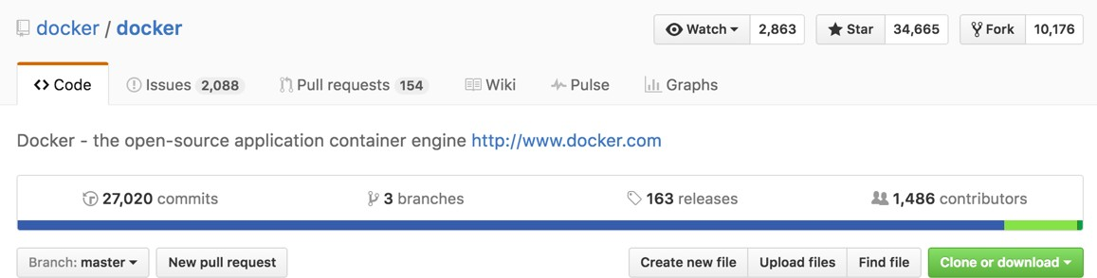
What is Docker?
Open source project and company
3

Slide 4
What is Docker?
Open source project and company
Used to create containers for software applications
3

Slide 5





WORA = Write Once Run Anywhere
{J,W,E}AR
Mac OS X Windows Ubuntu CentOS
4

Slide 6
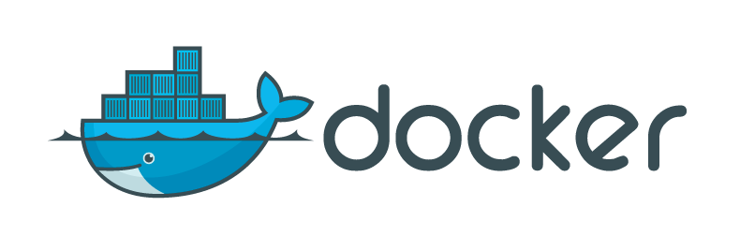



{J,W,E}AR
Mac OS X Windows Ubuntu CentOS
WORA = Write Once Run Anywhere
Image
Mac OS X Windows Ubuntu CentOS
PODA = Package Once Deploy Anywhere
©2016 Couchbase Inc.
4

Slide 7



Docker Mission
Build
Ship
Run
Distributed Applications
Anywhere
5

Slide 8
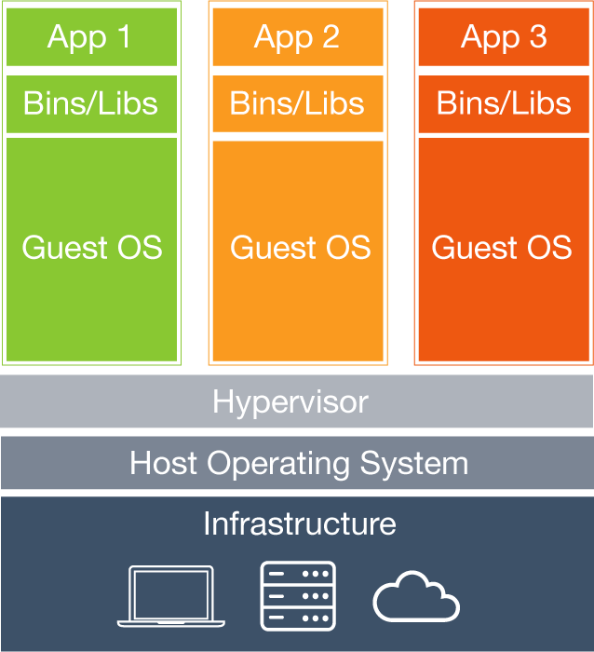
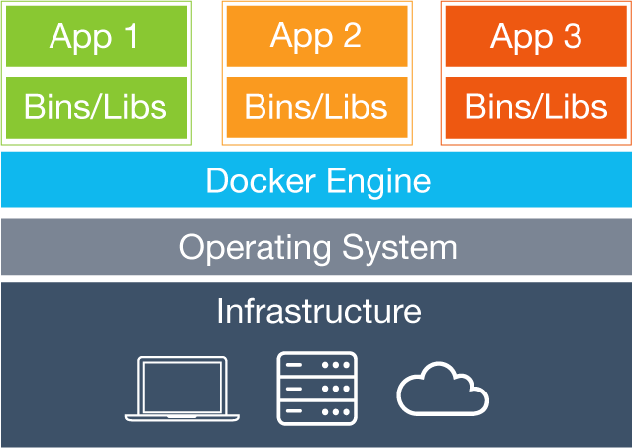
6

Slide 9
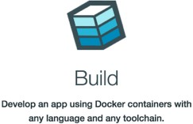
7

Slide 10


ubuntu
CMD echo “Hello
FROM
world”
7

Slide 11



ubuntu
CMD echo “Hello
FROM
world”
FROM
openjdk
COPY
target/hello.jar
/usr/src/hello.jar
CMD java -cp
/usr/src/hello.jar org.example.App
7

Slide 12
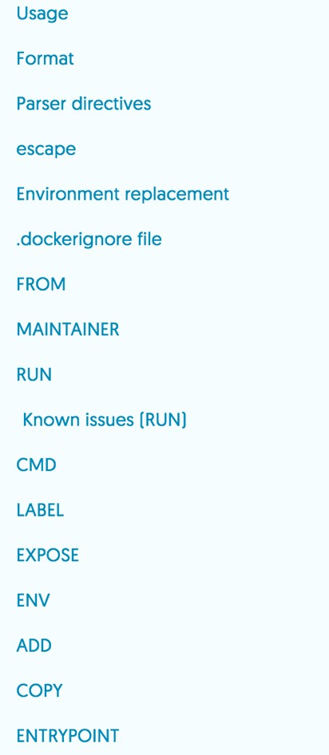
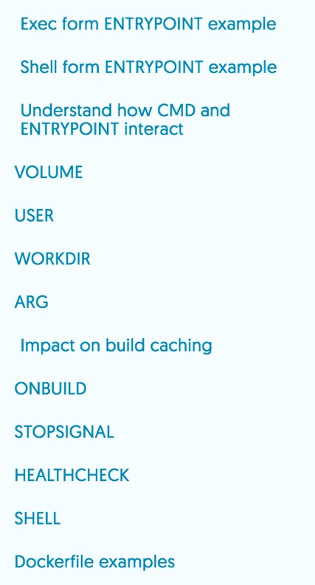
©2016 Couchbase Inc.
8
https://docs.docker.com/engine/reference/builder/

Slide 13
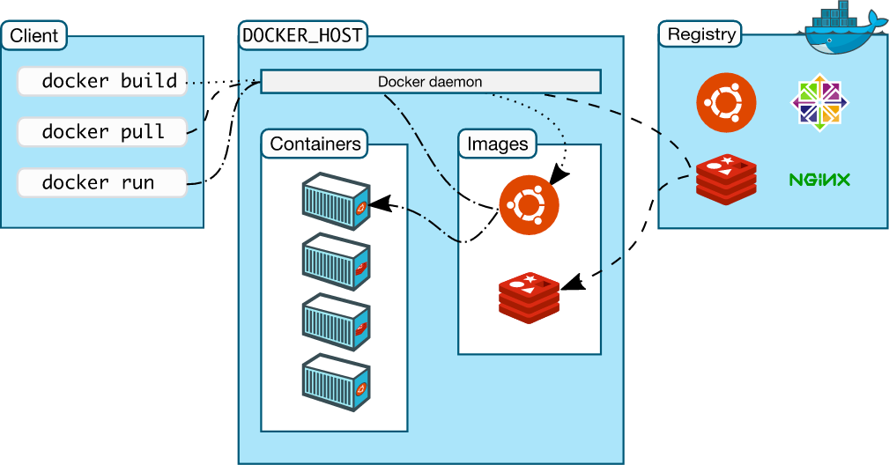


Docker Workﬂow

Slide 14
Image Layers - OpenJDK
~ > docker | images | openjdk
REPOSITORY |  | TAG | IMAGE | ID | CREATED | SIZE
openjdk
latest
openjdk
CREATED
ea40c858f006
CREATED BY
13 days ago
643.1 MB
~ > docker history
IMAGE COMMENT
ea40c858f006
<missing>
SIZE
13 days ago
13 days ago
/bin/sh
/bin/sh
-c /var/lib/dpkg/info/ca-certificates
-c set -x && apt-get update && apt-
418.2 kB
349.3 MB
<missing> | 13 | days | ago | /bin/sh | -c | #(nop) ENV CA_CERTIFICATES_JAVA_V |  | 0 | B
<missing> | 13 | days | ago | /bin/sh | -c | #(nop) ENV JAVA_DEBIAN_VERSION=8u |  | 0 | B
<missing> | 13 | days | ago | /bin/sh | -c | #(nop) ENV JAVA_VERSION=8u102 |  | 0 | B
<missing> | 13 | days | ago | /bin/sh | -c | #(nop) ENV JAVA_HOME=/usr/lib/jvm |  | 0 | B
<missing> | 13 | days | ago | /bin/sh | -c | { echo '#!/bin/sh'; echo 'set |  | 87 | B
<missing> | 13 | days | ago | /bin/sh | -c | #(nop) ENV LANG=C.UTF-8 |  | 0 | B
<missing> | 13 | days | ago | /bin/sh | -c | echo 'deb http://httpredir.debian. |  | 61 | B
<missing> | 13 | days | ago | /bin/sh | -c | apt-get | update && apt-get install | 1.289 |  | MB
<missing> | 2 | weeks | ago | /bin/sh | -c | apt-get | update && apt-get install | 122.6 |  | MB
<missing> | 2 | weeks | ago | /bin/sh | -c | apt-get | update && apt-get install | 44.31 |  | MB
<missing> | 2 | weeks | ago | /bin/sh | -c | #(nop) | CMD ["/bin/bash"] | 0 B
<missing> | 2 | weeks | ago | /bin/sh | -c | #(nop) | ADD file:f2453b914e7e026efd | 125.1 |  | MB

Slide 15
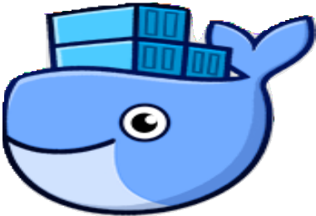

Docker for Mac/Windows
11

Slide 16
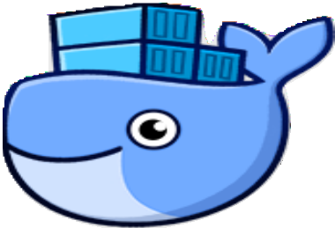

Docker for Mac/Windows
Native application and UI
11

Slide 17
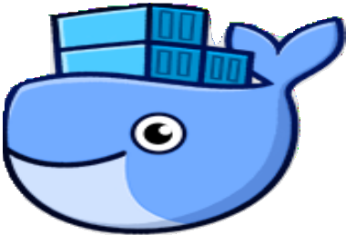

Docker for Mac/Windows
Native application and UI
Auto update capability
11

Slide 18
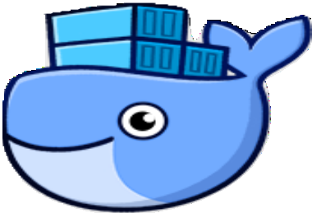

Docker for Mac/Windows
Native application and UI
Auto update capability
No additional software required, e.g. VirtualBox
11

Slide 19
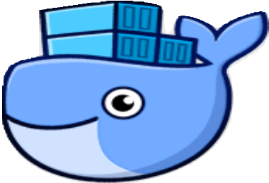

Docker for Mac/Windows
Native application and UI
Auto update capability
No additional software required, e.g. VirtualBox
– OSX: xhyve VM using Hypervisor.framework
11

Slide 20
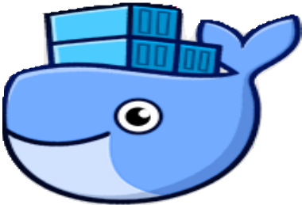

Docker for Mac/Windows
Native application and UI
Auto update capability
No additional software required, e.g. VirtualBox
– OSX: xhyve VM using Hypervisor.framework
Windows: Hyper-V VM
–
11

Slide 21
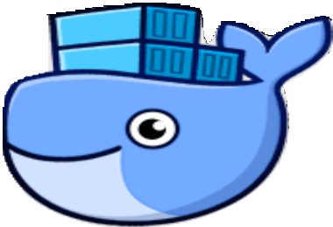

Docker for Mac/Windows
Native application and UI
Auto update capability
No additional software required, e.g. VirtualBox
– OSX: xhyve VM using Hypervisor.framework
Windows: Hyper-V VM
–
Download: docker.com/getdocker
11

Slide 22
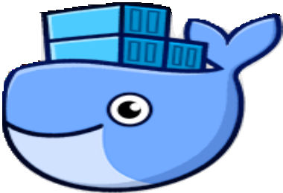

Docker for Mac/Windows
Native application and UI
Auto update capability
No additional software required, e.g. VirtualBox
– OSX: xhyve VM using Hypervisor.framework
Windows: Hyper-V VM
–
Download: docker.com/getdocker
Requires Yosemite 10.10+ or Windows 10 64-bit
11

Slide 23


Docker for AWS/Azure
12

Slide 24
Docker for AWS/Azure
Amazon Web Services
12

Slide 25
Docker for AWS/Azure
Amazon Web Services
– Amazon CloudFormation templates
12

Slide 26
Docker for AWS/Azure
Amazon Web Services
– Amazon CloudFormation templates Integrated with Autoscaling, ELB, and EBS
–
12

Slide 27
Docker for AWS/Azure
Amazon Web Services
– Amazon CloudFormation templates Integrated with Autoscaling, ELB, and EBS
–
Azure
12

Slide 28
Docker for AWS/Azure
Amazon Web Services
– Amazon CloudFormation templates Integrated with Autoscaling, ELB, and EBS
–
Azure
– Integrated with VM Scale Sets for autoscaling, Azure Load Balancer, Azure Storage
12

Slide 29
Docker for AWS/Azure
Amazon Web Services
– Amazon CloudFormation templates Integrated with Autoscaling, ELB, and EBS
–
Azure
Integrated with VM Scale Sets for autoscaling, Azure Load Balancer, Azure Storage
beta.docker.com (restricted availability)
–
12

Slide 30
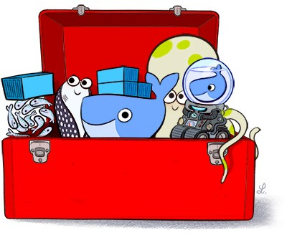
Docker Toolbox
Docker Engine
Docker Machine
Docker Compose
Docker Kitematic
Virtual box
Quickstart Terminal
©2016 Couchbase Inc.
13
https://www.docker.com/toolbox

Slide 31
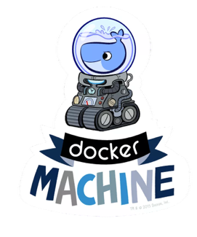
Docker Machine
14

Slide 32
Docker Machine
Create Docker Host on computer or cloud provider
docker-machine create --driver=virtualbox myhost
14

Slide 33
Docker Machine
Create Docker Host on computer or cloud provider
docker-machine create --driver=virtualbox myhost
– Configure Docker client to talk to host
14

Slide 34
Docker Machine
Create Docker Host on computer or cloud provider
docker-machine create --driver=virtualbox myhost
Configure Docker client to talk to host
Create and pull images
14

Slide 35
Docker Machine
Create Docker Host on computer or cloud provider
docker-machine create --driver=virtualbox myhost
– Configure Docker client to talk to host Create and pull images
Start, stop, restart containers
–
–
14

Slide 36
Docker Machine
Create Docker Host on computer or cloud provider
docker-machine create --driver=virtualbox myhost
– Configure Docker client to talk to host Create and pull images
Start, stop, restart containers Upgrade Docker
–
–
–
14

Slide 37
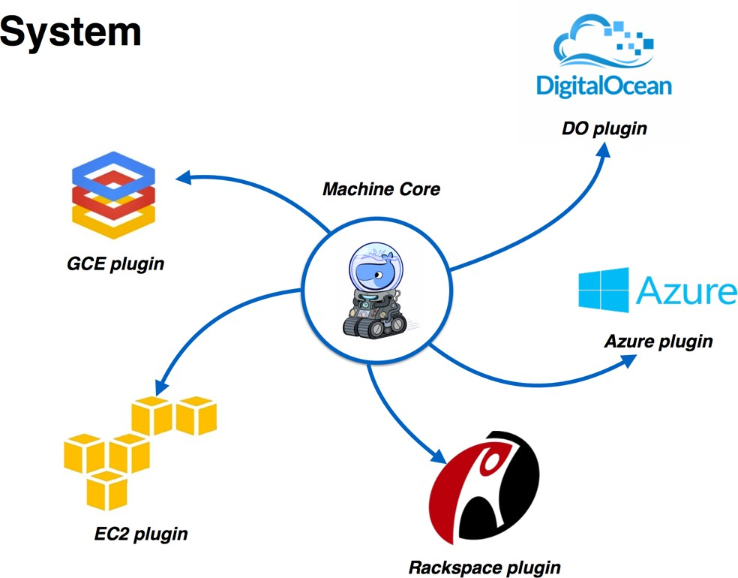
Docker Machine Providers

Slide 38
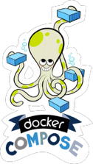
Docker Compose
16

Slide 39
Docker Compose
Defining and running multi-container applications
16

Slide 40
Docker Compose
Defining and running multi-container applications
Configuration defined in one or more files
16

Slide 41
Docker Compose
Defining and running multi-container applications
Configuration defined in one or more files
– docker-compose.yml (default)
16

Slide 42
Docker Compose
Defining and running multi-container applications
Configuration defined in one or more files
– docker-compose.yml (default)
docker-compose.override.yml (default)
–
16

Slide 43
Docker Compose
Defining and running multi-container applications
Configuration defined in one or more files
– docker-compose.yml (default)
docker-compose.override.yml (default) Multiple files specified using -f
–
–
16

Slide 44
Docker Compose
Defining and running multi-container applications
Configuration defined in one or more files
– docker-compose.yml (default)
docker-compose.override.yml (default) Multiple files specified using -f
All paths relative to base configuration file
–
–
–
16

Slide 45
Docker Compose
Defining and running multi-container applications
Configuration defined in one or more files
– docker-compose.yml (default)
docker-compose.override.yml (default) Multiple files specified using -f
All paths relative to base configuration file
–
–
–
Great for dev, staging, and CI
16

Slide 46


Docker Compose - One Service
version: “2” services:
db:
image: couchbase volumes:
- ~/couchbase:/opt/couchbase/var ports:
- 8091:8091
- 8092:8092
- 8093:8093
- 11210:11210
docker-compose up -d

Slide 47



Docker Compose - Two Services
GET POST PUT DELETE
CRUD
using N1QL

Slide 48


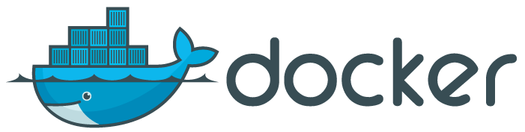


Docker Compose - Two Services
version: “2” services:
db:
image: couchbase ports:
- 8091:8091
- 8092:8092
- 8093:8093
- 11210:11210
web:
image: arungupta/wildfly environment:
- COUCHBASE_URI=db
ports:
- 8080:8080
- 9990:9990
19

Slide 49
Docker Compose - Two Services
version: “2” services:
db:
image: couchbase ports:
- 8091:8091
- 8092:8092
- 8093:8093
- 11210:11210
web:
image: arungupta/wildfly environment:
- COUCHBASE_URI=db
ports:
- 8080:8080
- 9990:9990
19

Slide 50


Overriding Services in Docker Compose
web:
image: jboss/wildfly ports:
- 8080:8080
docker-compose.yml
20

Slide 51


Overriding Services in Docker Compose
web:
image: jboss/wildfly ports:
- 8080:8080
docker-compose.yml
web:
ports:
- 9080:8080
docker-compose.override.yml
20

Slide 52
Overriding Services in Docker Compose
web:
image: jboss/wildfly ports:
- 8080:8080
docker-compose.yml
web:
ports:
- 9080:8080
docker-compose.override.yml
docker-compose up -d
20

Slide 53




Dev/Prod with Compose
docker-compose.yml
db-dev:
image: arungupta/couchbase ports:
- . . .
web:
image: arungupta/wildfly environment:
- COUCHBASE_URI=db-dev:8093
ports:
- 8080:8080
docker-compose up -d
21

Slide 54
Dev/Prod with Compose
docker-compose.yml
db-dev:
image: arungupta/couchbase ports:
- . . .
web:
image: arungupta/wildfly environment:
- COUCHBASE_URI=db-dev:8093
ports:
- 8080:8080
docker-compose up -d
21

Slide 55


Dev/Prod with Compose
docker-compose.yml
db-dev:
image: arungupta/couchbase ports:
- . . .
web:
image: arungupta/wildfly environment:
- COUCHBASE_URI=db-dev:8093
ports:
- 8080:8080
docker-compose up -d
web: environment:
production.yml
-
COUCHBASE_URI=db-prod:8093
ports:
-
80:8080
db-prod: image:
.
.
.
21

Slide 56
Dev/Prod with Compose
docker-compose.yml
db-dev:
image: arungupta/couchbase ports:
- . . .
web:
image: arungupta/wildfly environment:
- COUCHBASE_URI=db-dev:8093
ports:
- 8080:8080
docker-compose up -d
web: environment:
production.yml
-
COUCHBASE_URI=db-prod:8093
ports:
-
80:8080
db-prod: image:
.
.
.
21

Slide 57


Dev/Prod with Compose
docker-compose.yml
db-dev:
image: arungupta/couchbase ports:
- . . .
web:
image: arungupta/wildfly environment:
- COUCHBASE_URI=db-dev:8093
ports:
- 8080:8080
docker-compose up -d
web: environment:
- COUCHBASE_URI=db-prod:8093
ports:
- 80:8080
db-prod: image: . . .
production.yml
docker-compose up
-f docker-compose.yml
-f production.yml
-d
©2016 Couchbase Inc.
21

Slide 58
Docker Compose Common Use Cases
22

Slide 59
Docker Compose Common Use Cases
Use Case Command
Dev Setup docker-compose up
22

Slide 60
Docker Compose Common Use Cases
Use Case Command
Dev Setup
docker-compose up
DOCKER_HOST, DOCKER_TLS_VERIFY,
Local/remote host
DOCKER_CERT_PATH
22

Slide 61
Docker Compose Common Use Cases
Use Case Command
Dev Setup
docker-compose up
DOCKER_HOST, DOCKER_TLS_VERIFY,
Local/remote host
DOCKER_CERT_PATH
Single/multiple hosts
Integrated with Swarm
22

Slide 62
Docker Compose Common Use Cases
Use Case Command
Dev Setup
docker-compose up
DOCKER_HOST, DOCKER_TLS_VERIFY,
Local/remote host
DOCKER_CERT_PATH
Single/multiple hosts Integrated with Swarm
Multiple isolated environments docker-compose up -p <project>
22

Slide 63
Docker Compose Common Use Cases
Use Case Command
Dev Setup
docker-compose up
DOCKER_HOST, DOCKER_TLS_VERIFY,
Local/remote host
DOCKER_CERT_PATH
Single/multiple hosts Integrated with Swarm
Multiple isolated environments docker-compose up -p <project>
Automated test setup docker-compose up mvn test
docker-compose down
22

Slide 64
Docker Compose Common Use Cases
Use Case Command
Dev Setup
docker-compose up
DOCKER_HOST, DOCKER_TLS_VERIFY,
Local/remote host
DOCKER_CERT_PATH
Single/multiple hosts Integrated with Swarm
Multiple isolated environments docker-compose up -p <project>
Automated test setup docker-compose up mvn test
docker-compose down
docker-compose up -f docker-compose.yml -f production.yml
Dev/Prod Impedance mismatch
22

